Slide 1
Cloud Technologies

Slide 2
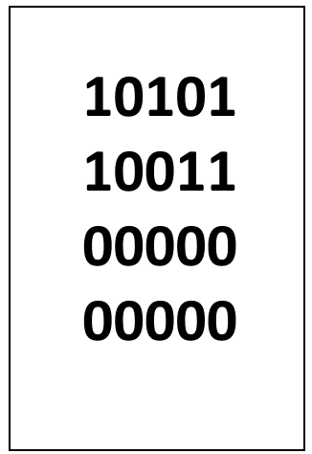
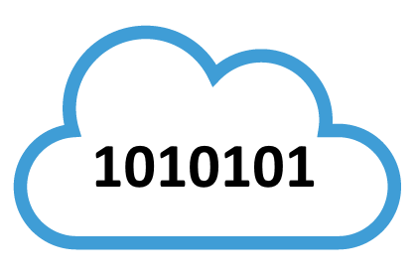
Misconceptions

Slide 3
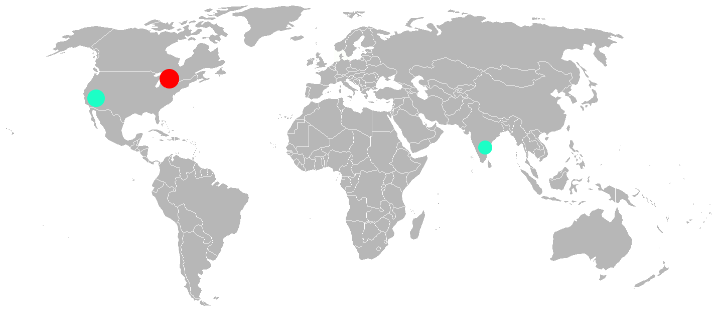
Technologies
Storage/Content Delivery Networks
Compute
https://cdn1.example.com/image.jpg

Slide 4

Ancestors (hosting)
University/Company page/server hosting

Slide 5
AWS and modern cloud computing
2006 - AWS EC2 (Elastic Cloud Compute)
2008 - Microsoft Azure
~2010-2013 - Google Compute Cloud/Engine
Present - Vendor specific improvements

Slide 6
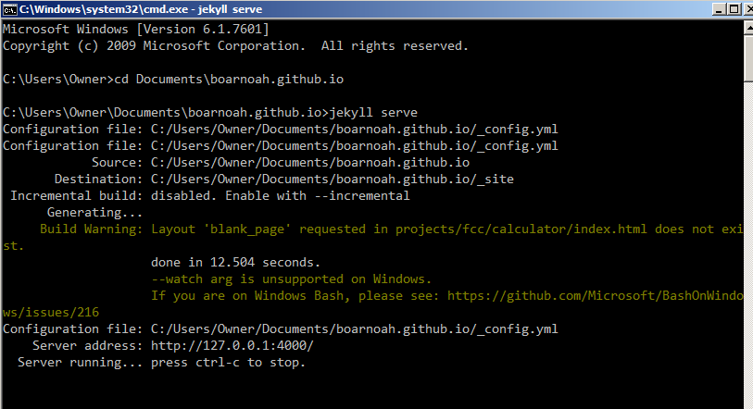
Servers

Slide 7
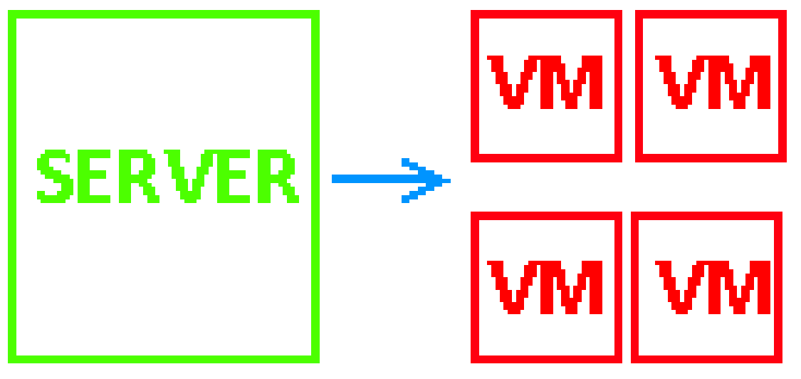
Hosting
Dedicated
Shared

Slide 8
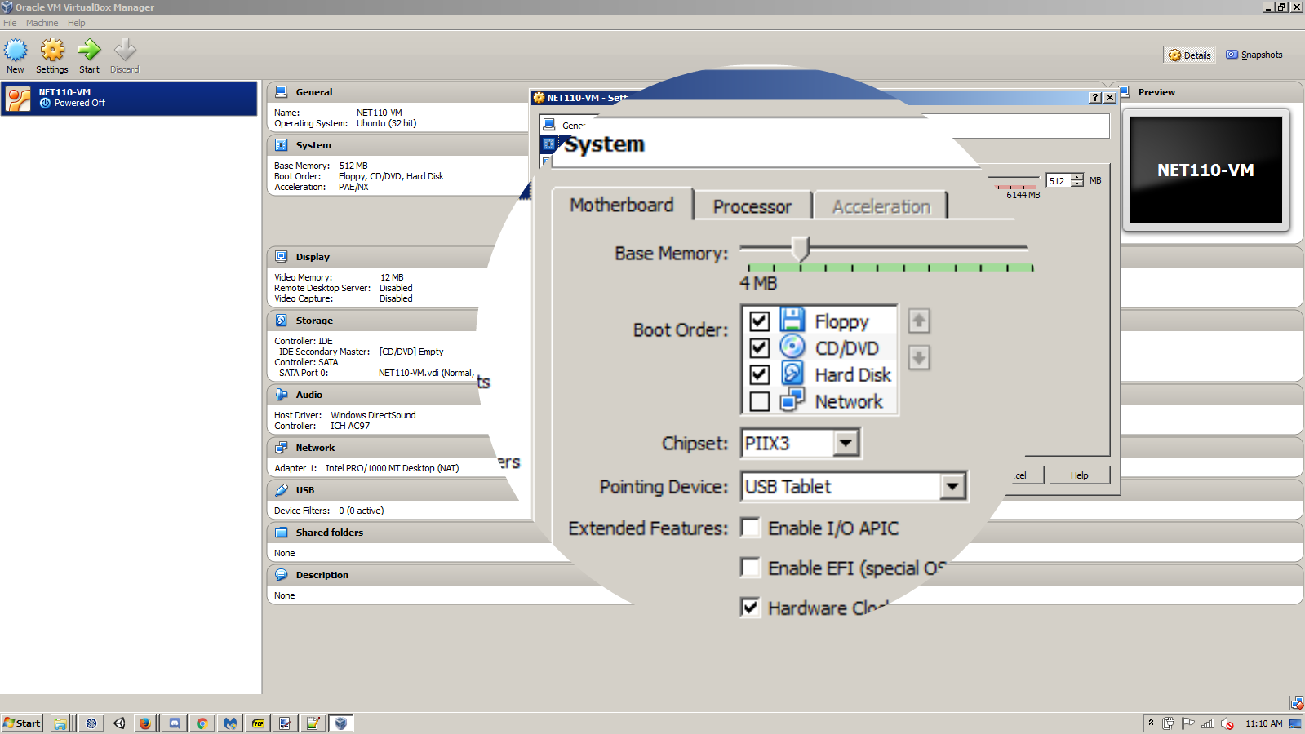
Virtual Machines

Slide 9
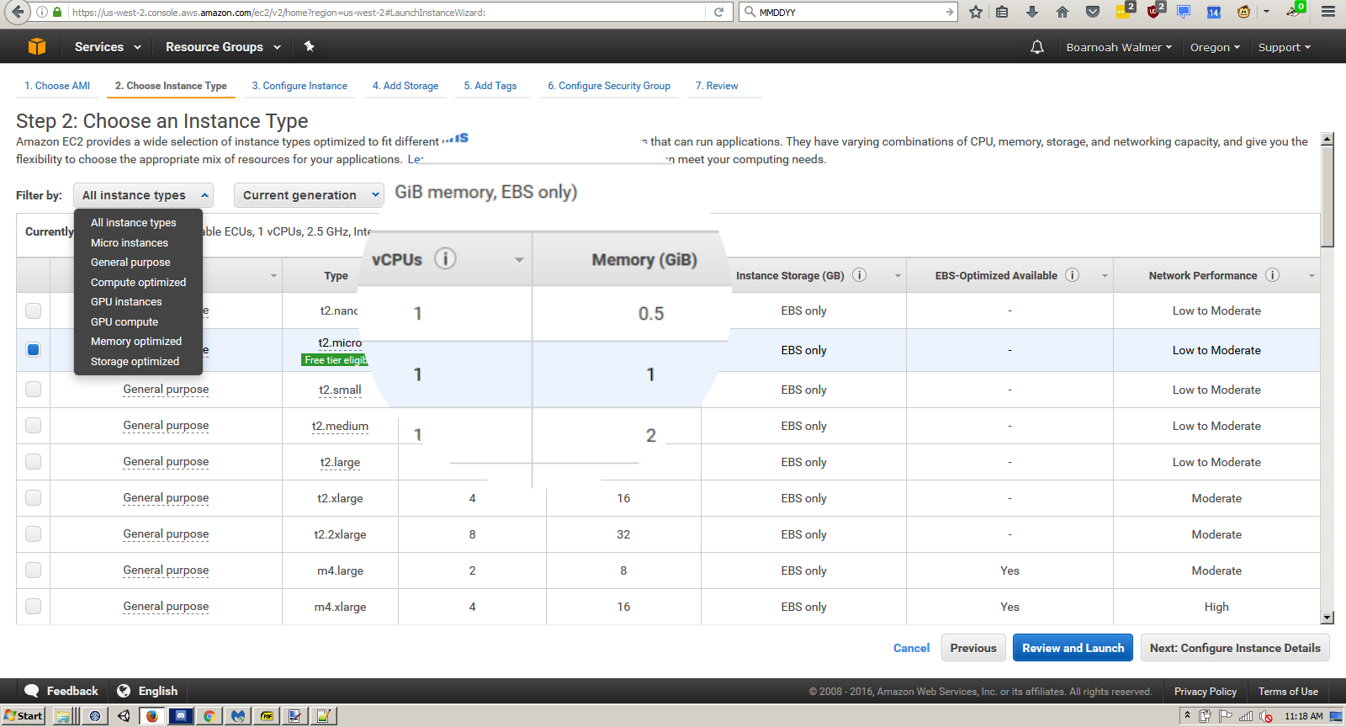
Virtual Machines (Cloud)

Slide 10
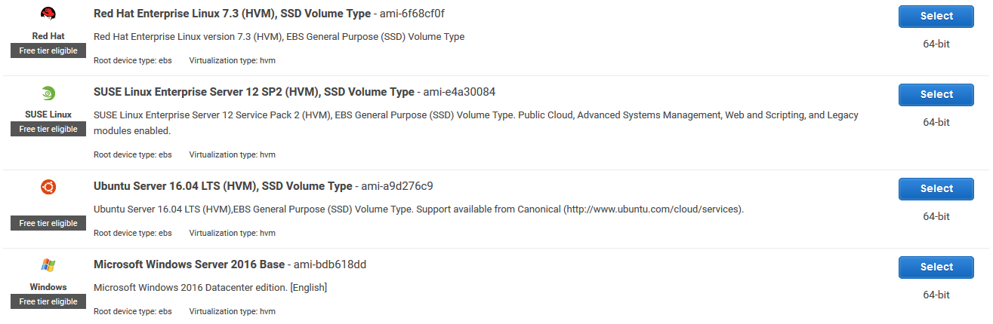
Premade Templates

Slide 11
Scaleable
Needs = Create Instances
Needs = Delete Instances

Slide 12


Efficient
Traditional
Cloud

Slide 13
Reliable
Uptime guarantees
Servers @ data centre

Slide 14


Vendor Lockin
:(

Slide 15
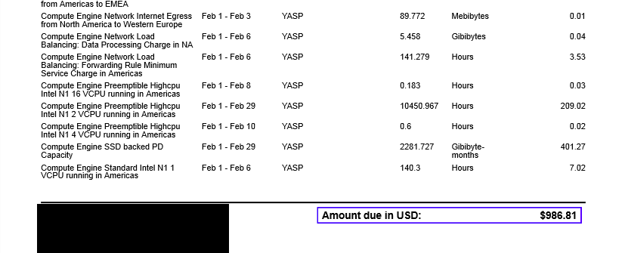
Long term costs
Data is expensive
http://blog.opendota.com/2016/03/20/financials/

Slide 16
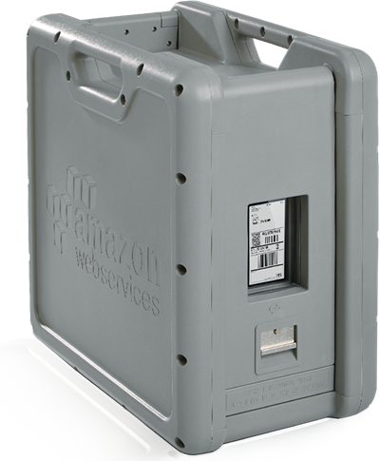
Data Issues
Costly
Stone age internet infrastructure (slow)

Slide 17
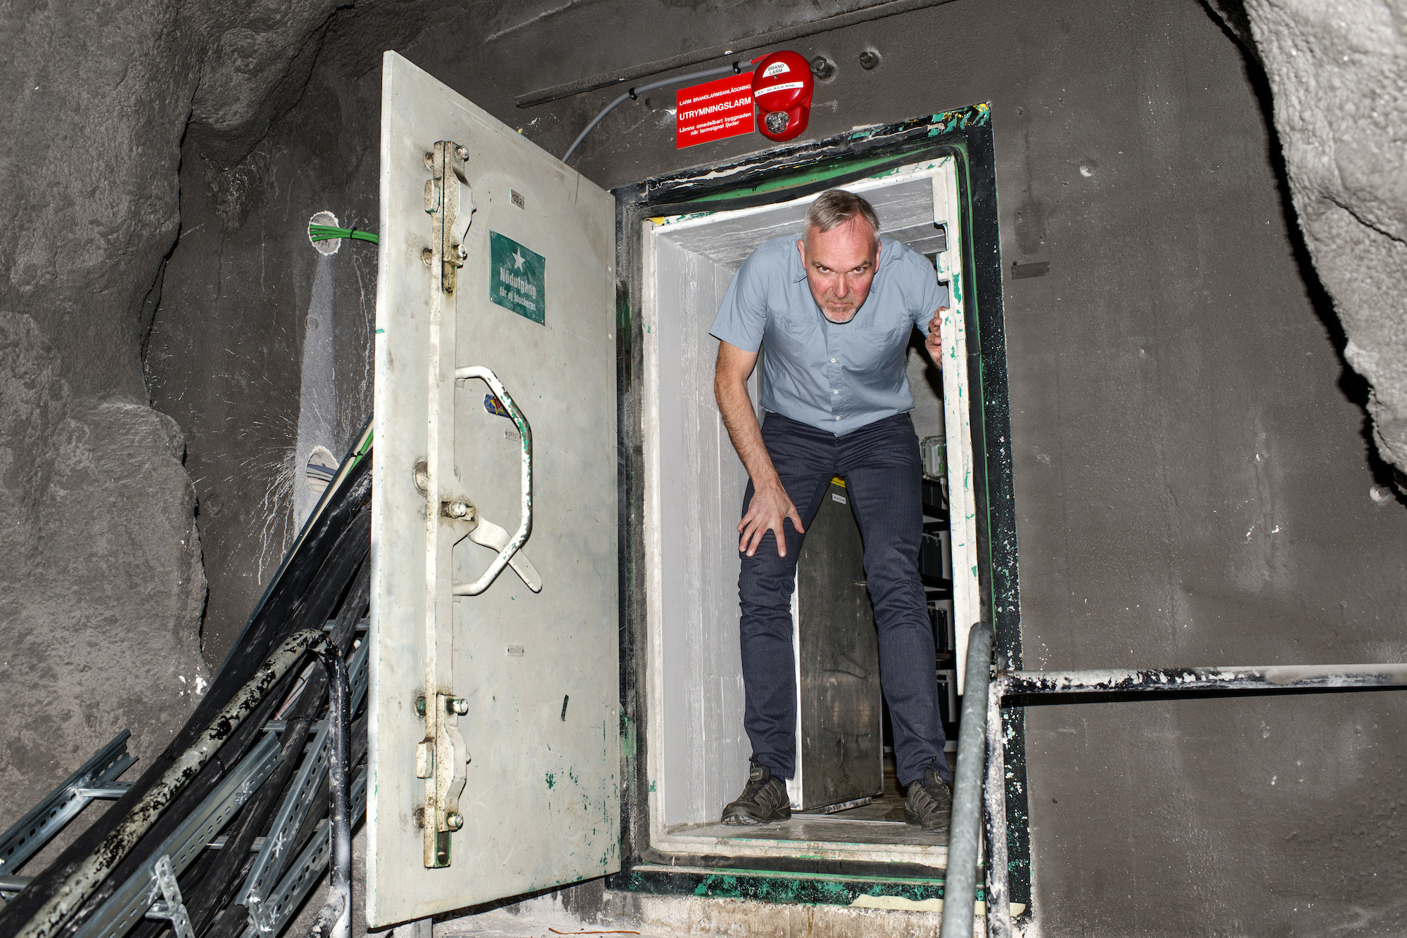
Privacy
Five Eyes (US, UK, CA, AU, NZ)
PRISM
http://www.vice.com/en_ca/read/the-man-in-the-web-2113

Slide 18

Extraordinary Rendition

Slide 19
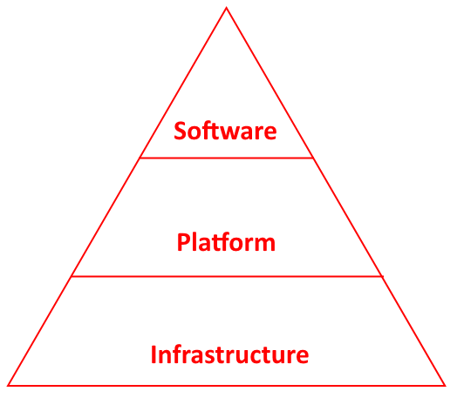
… as a Service
Different vendors for each stage of stack

Slide 20



Software as a Service (SaaS)

Slide 21



Platform as a Service
JavaScript content delivery
Google Compute Engine (Cloud Compute)
Cloud Compute

Slide 22

Infrastructure as a Service (IaaS)
Rackspace

Slide 23
Applications
Personal Projects, Students
Startups, Prototypes
Large scale compute tasks

Slide 24
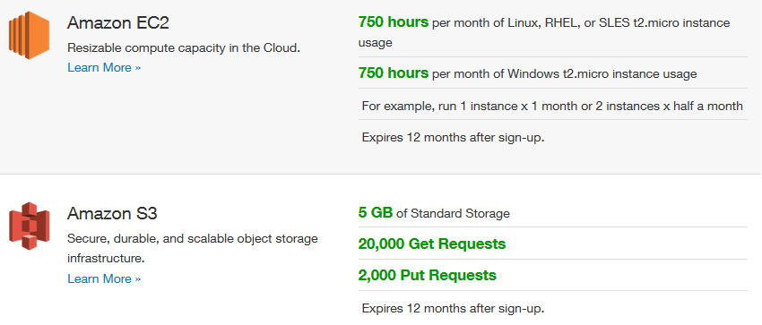
Personal Projects

Slide 25

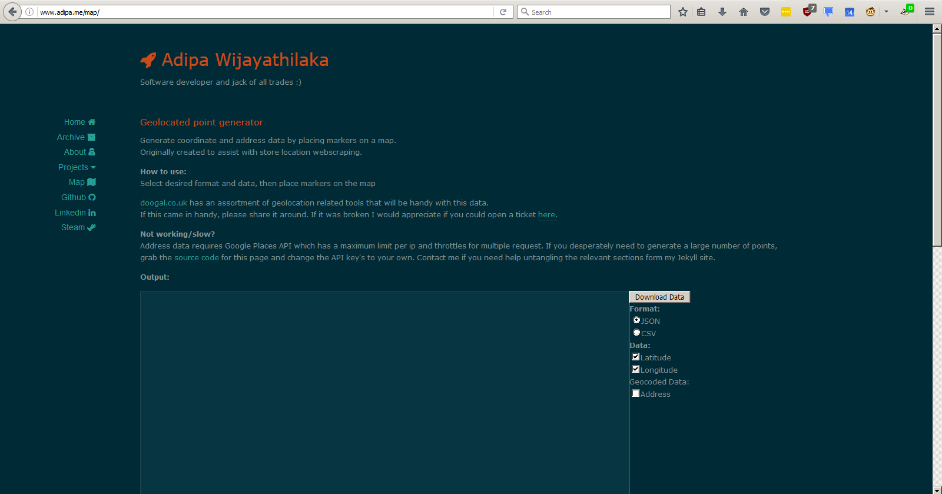

Static Page Hosting
(Free Student Domain)

Slide 26
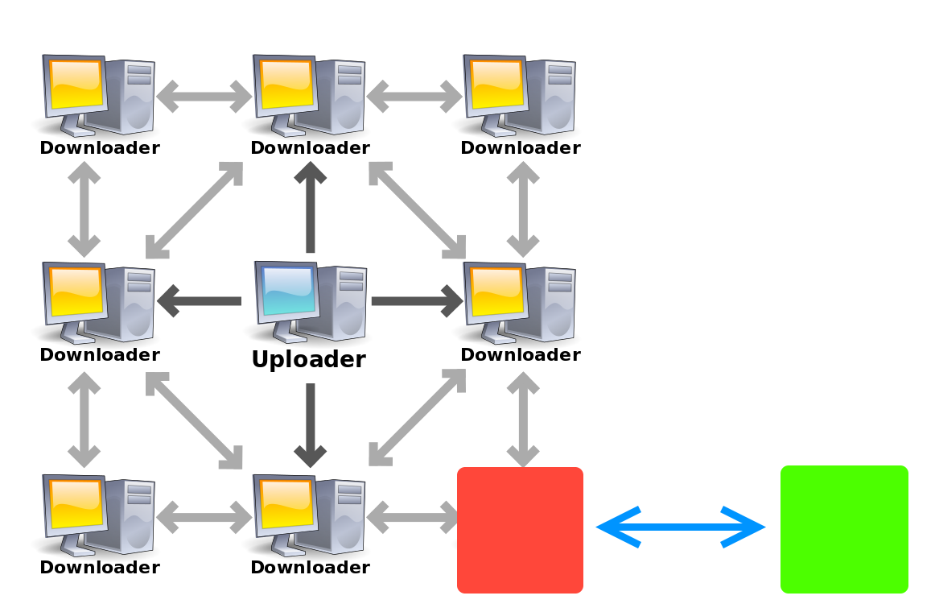
Seedboxes

Slide 27
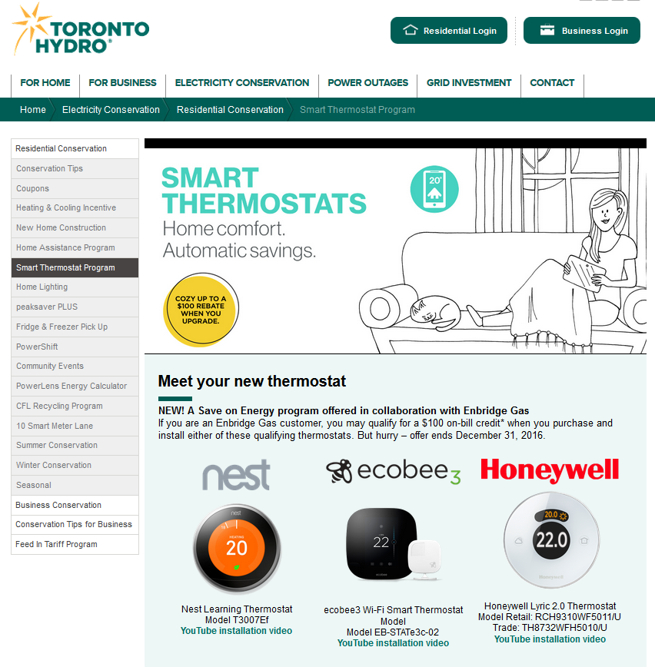
Home Automation
“Internet of Things”

Slide 28

Companies

Slide 29
Large Scale Compute (“Big Data”)
Analytics
Simulations
Ex:
Google BigData/BigQuery

Slide 30
Experience (how to)
Try it for yourself (Student Promos)
Certifications:
AWS Certification
CompTia Cloud+
Microsoft Cloud Certifications

Slide 31
...

